Slide 1
Data Structures (DS)
Week – 02
Sep 7-11, 2020
Instructor: Basit Ali
Email: Basit.jasani@nu.edu.pk
Data Structures (CS-201)

Slide 2
Data Type
Set of data with predefined values
OR
Something that can store particular “type” of values

Slide 3
Data Type
At the top level, there are two types of data types:
Primitive Data Types (System-defined Data Types)
User-defined Data Types

Slide 4
Primitive Data Types
Data types defined by the system
Examples are: int, float, char, double, etc.

Slide 5
User-defined Data Types
Most programming languages allow users to define their own data types
Examples are: structures in C, classes in C++ & JAVA

Slide 6
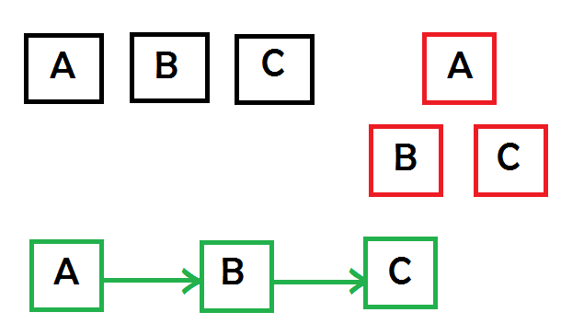
Data Structures
Data structure is a particular way of storing and arranging data (in a computer) so that it can be used efficiently

Slide 7
Abstract Data Type (ADT)
All primitive data types (int, float etc.) support basic operations like addition, subtraction
But what about user-defined data types???

Slide 8
ADT
ADT = Abstract Data Types
A logical view of the data objects together with specifications of the operations required to create and manipulate them.
Describe an algorithm – pseudo-code
Describe a data structure – ADT

Slide 9
Arrays
Array: a set of pairs (index and value)
data structure
For each index, there is a value associated with that index.
representation (possible)
implemented by using consecutive memory.

Slide 10
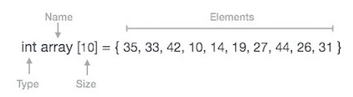
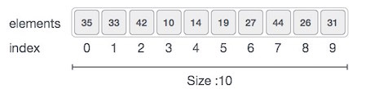
Array Representation
Arrays can be declared in various ways in different languages. For illustration, let's take C++ array declaration.

Slide 11
Example
#include <iostream>
void print1(int *ptr, int rows)
{
int i;
cout << "Address Contents" << endl;
for (i=0; i < rows; i++)
cout << ptr+i << " " << *(ptr+i) << endl;
}
void main(){
int one[] = {0, 1, 2, 3, 4}; //Goal: print out address and value
print1(one, 5);
}
Address Contents
0xbffffbb4 0
0xbffffbb8 1
0xbffffbbc 2
0xbffffbc0 3
0xbffffbc4 4

Slide 12
Basic Operations
Following are the basic operations supported by an array.
Traverse − print all the array elements one by one.
Insertion − Adds an element at the given index.
Deletion − Deletes an element at the given index.
Search − Searches an element using the given index or by the value.
Update − Updates an element at the given index.

Slide 13
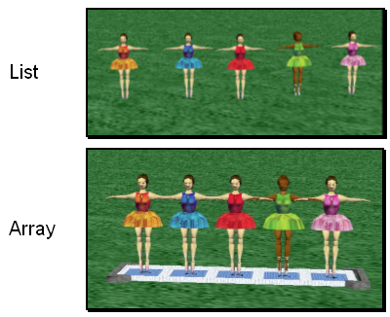
Arrays & Lists
Two built-in data structures that can be used to organize data, or to create other data structures:
Lists
Arrays

Slide 14
Lists
A list is an ordered set of data. It is often used to store objects that are to be processed sequentially.
A list can be used to create a queue.

Slide 15
Arrays
An array is an indexed set of variables, such as dancer_{[1]}, dancer_{[2]}, dancer_{[3]},… It is like a set of boxes that hold things.
A list is a set of items.
An array is a set of variables that each store an item.

Slide 16
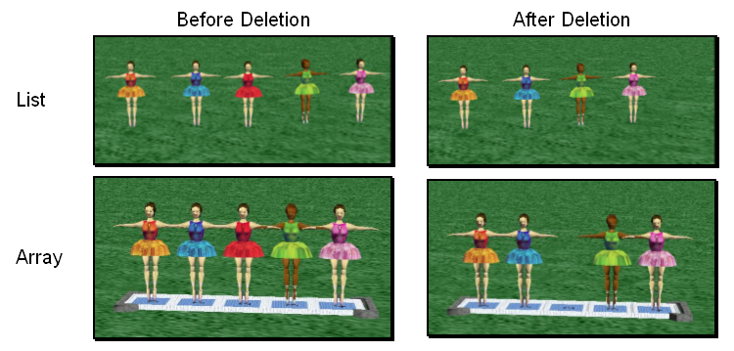
Arrays & Lists
You can see the difference between arrays and lists when you delete items.

Slide 17
Arrays & Lists
In a list, the missing spot is filled in when something is deleted.

Slide 18
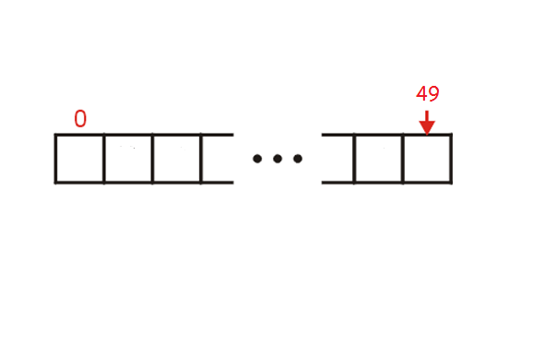
Class Activity!

Slide 19
Rule OF Three in C++
Reading Material Shared!

Slide 20
Recursive Thinking
Recursion splits a problem:
Into one or more simpler versions of itself
The General Approach
if problem is “small enough”
solve it directly
else
break into one or more smaller subproblems
solve each subproblem recursively
combine results into solution to whole problem

Slide 21
General Recursive Design Strategy
Identify the base case(s) (for direct solution)
Devise a problem splitting strategy
Subproblems must be smaller
Subproblems must work towards a base case
Devise a solution combining strategy

Slide 22
Example
public static int factorial (int n)
{
if (n == 0) // or: throw exc. if < 0
return 1;
else
return n * factorial(n-1);
}

Slide 23
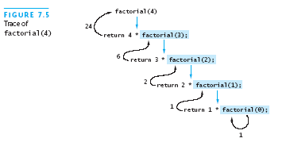
Example

Slide 24
Recursion Versus Iteration
Recursion and iteration are similar
Iteration:
Loop repetition test determines whether to exit
Recursion:
Condition tests for a base case
Can always write iterative solution to a problem solved recursively, but:
Recursive code often simpler than iterative
Thus easier to write, read, and debug

Slide 25
Efficiency of Recursion
Recursive method often slower than iterative; why?
Overhead for loop repetition smaller than
Overhead for call and return
If easier to develop algorithm using recursion,
Then code it as a recursive method:
Software engineering benefit probably outweighs ...
Reduction in efficiency
Don’t “optimize” prematurely!

Slide 26
Array of Objects (Dynamically)
Rectangle *p;
try {
p = new Rectangle [3];
} catch (bad_alloc xa) {
cout << "Allocation Failure\n";
return 1;
}
//free
delete [] p;

